Slide 1
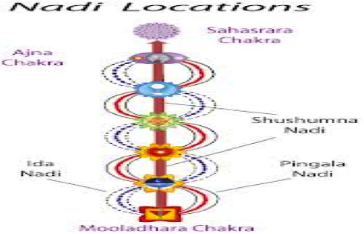
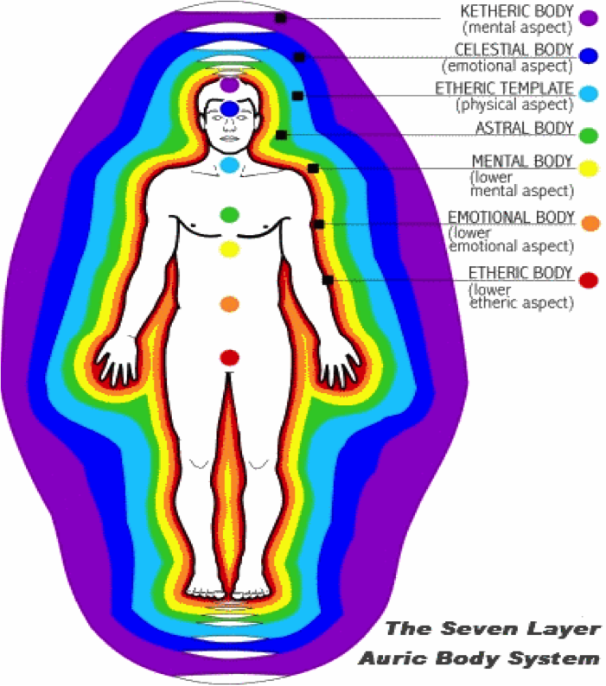
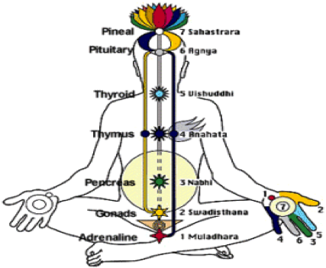
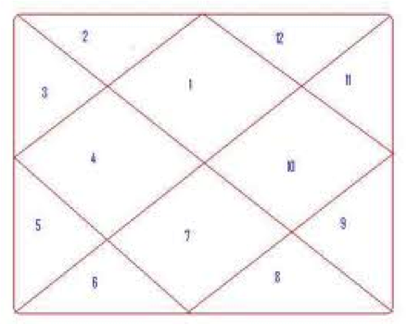
Four Foundations of Life

Slide 2
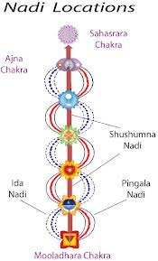
Nadis
The two Nadis are believed to be stimulated through different Pranayamapractices which involves alternate breathing through right and left nostrils. When any Nadi is not functioning normally, it shows Negative energy. This is generally the case when the person is seriously ill and medicines do not work. Reiki healing and other healing technicques can make the Nadi positive. It then starts functioning normally and medicines start working on him. Yogis activate SushumnaNadi by prnayamto attain Dharana, Dhyan and Samadhi because Sushumnaconnects the base chakra to the crown chakra.
Nadis are thought to carry a life force energy known as Prana or Chi. There are three Nadis : Ida, Pingla and Sushumna. Pingla is the Suryanadi and corresponds to the right hand side of the body. Ida is the introverted Chandranadi and corresponds to the left hand side of the body.

Slide 3
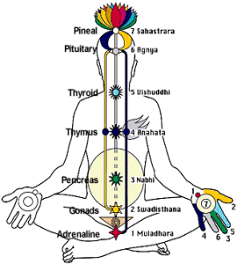
Chakra
Chakra | Disease
1. Muladhar | Spinal column, kidneys.
2. Swadhistan | Reproductive system.
3. Manipur | Stomach, Liver, Gall bladder, Nervous system.
4. Heart | Heart, Blood, Vagus nerve, Circulatory system.
5. Throat | Bronchial and Vocal apparatus, Lungs
6. Ajna | Lower brain, Left eye, Ears, Nose.
7. Sahasrar | Upper brain Right eye.
Chakras are the spinning wheels located on Nadis feeding them subtle energies generated during their spin. This happens continuously day in and day out as a gift of God.
When any chakra is not functioning normally, it shows Negative Energy and the person get disease as per the following chart:

Slide 4
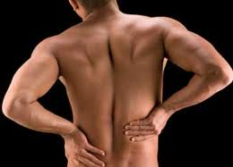
For example backache may be due to Nagative Muladhar Chakra. Healing of the chakra can bring back normal health. Depending upon severity of disease more number of healing session are required Continuous spinning of seven chakras feed subtle energy to Aura.

Slide 5
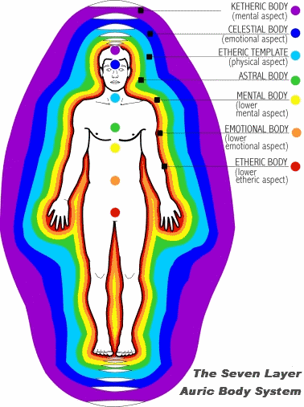
Aura
An aura is a field of subtle, luminous radiation surrounding a person or object. The depiction of such an aura often cannotes a person of particular power or holiness. It has been described as a map of the thoughts and feeling surrounding a person. Positive Chakras create positive and healthy aura. Negative weak Chakras create negative and weak aura. When aura of a person becomes negative, he invites problems in finance, health and in social life. Healing of aura brings back happiness again.

Slide 6
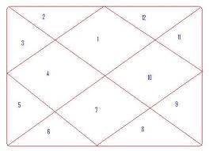
12 Houses of Astrology
There are twelve Houses of Astrology. Birth time and Birth place decide position of planets in the 12 Houses of Birth Chart. This plays very important role in activities of our day today life. Each House specifies specific property as follows:

Slide 7
12 Houses of Astrology Table
House | Names | Significance
First House | Lagnsthan | Life, longevity,nature and appearance of native.
Second House | Dhanasthan | Finance, right eye.
Third House | Bhatrusthan | Brothers and sisters.
Fourth House | Matrusthan | Mother, property, and happiness.
Fifth House | Putrasthan | Children, and luck
Sixth House | Rogsthan | Enemies, health.
Seventh House | Bharyasthan | Wife, husband, and partnership.
Eight House | Mrutyusthan | Diseases, death.
Ninth House | Bhagyasthan | Luck, prosperity, religion, and foreign travel.
Eight House | Mrutyusthan | Diseases, death.
Ninth House | Bhagyasthan | Luck, prosperity, religion, and foreign travel.
Tenth House | Karmasthan | Profession and Government favor
Eleventh House | labhasthan | Wealth.
Twelfth House | Vyayasthan | Enemies, law suits, imprisonments.

