Slide 1
Prayer Timings for Health, Wealth and Happiness

Slide 2
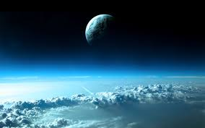
Dictionary meaning of Atmosphere is Gasses surrounding earth and other planets. It is quiet in normal course.
Meaning of Atmosphere

Slide 3
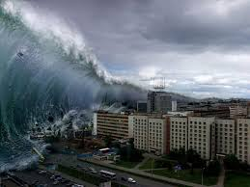
Atmosphere Changes
As per religious Books major Disturbances in atmosphere take place 72 min before sunrise, at sunrise, at midday & at sunset. Dark Energy is generated at these times and enters our Aura. .

Slide 4
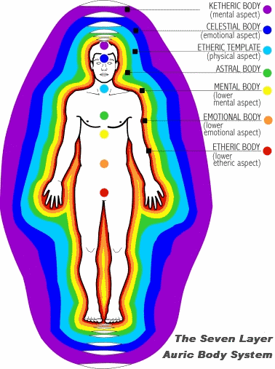
Aura
All living beings have auric body. It is a vibrational body surrounding our physical body. Dark energy at above times enter our auric body and brings us unhappiness.

Slide 5
Sickness
Unhappiness can come in the form of sickness in our physical body, like Heart problems, breathing problems & even cancer.

Slide 6
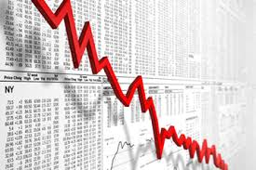
Financial Loss
Dark energy also disturbs our prosperity and brings financial loss. It also disturbs our family and social life.

Slide 7
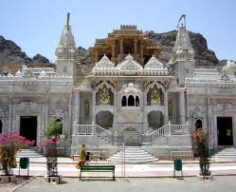
Jain prayers
According to jain religion seven times prayers in a day keeps us healthy, wealthy & prosperous. These are the timings when there is disturbance in Atmosphere resulting in generation of dark energy.

Slide 8
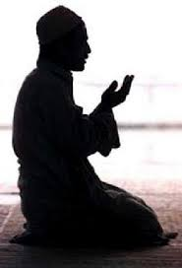
Islamic namaj
According to islam religion also there are seven times of prayers (namaj).

Slide 9
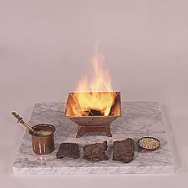
Agnihotra
Many people in 62 countries of the world perform agnihotra at specific time of sunrise and sunset. According to a survey, persons performing agnihotra regularly are healthy wealthy and prosperous.

Slide 10
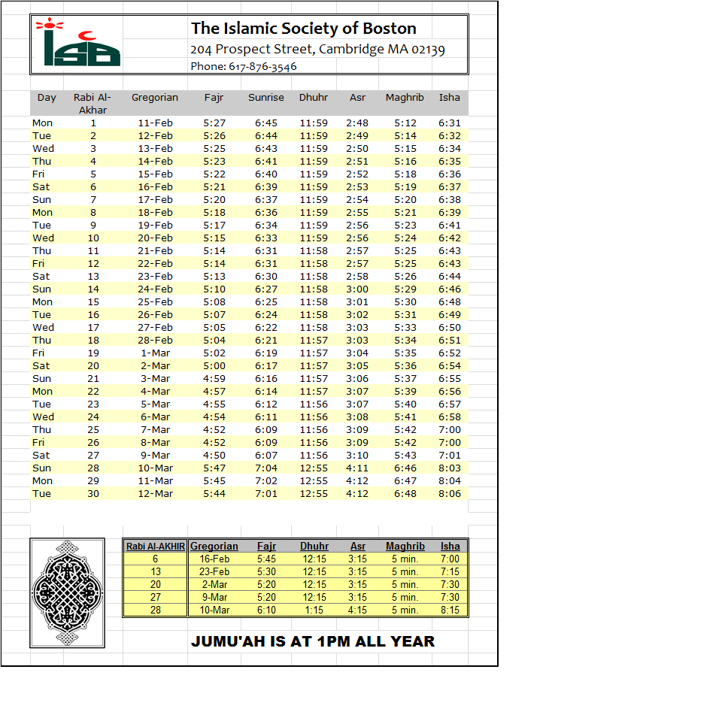
Timing of prayers
Prayer timings mentioned in religious books are very important because these are the times when dark energy is generated in the atmosphere.

Slide 11
Conclusion
If these timings of prayers are observed properly, we get protection from dark energy and remain Healthy Wealthy and prosperous.

